Slide 1
TEST YOUR IQ
Reviewer-
Ms.Vasantha
Assistant Professor
PRESENTED BY-
Alankrita Srivastava
1NH16CS700

Slide 2
CONTENTS
Introduction
Requirements
Oop concepts
Flow Chart
Output

Slide 3
Introduction
An intelligence quotient (IQ) is a total score derived from several standardize tests designed to access human intelligence
Scores from intelligence tests are estimates of intelligence. Unlike, for example, distance and mass, a concrete measure of intelligence cannot be achieved given the abstract nature of the concept of intelligence.
This test is provided with some IQ level questions which will help you to test your IQ.
This test will be very beneficial for improving your thinking ability and improving it by attempting tests related to IQ.
This program contains the concepts of oops in c++ like Classes, Inheritence, polymorphism, inheritance.

Slide 4
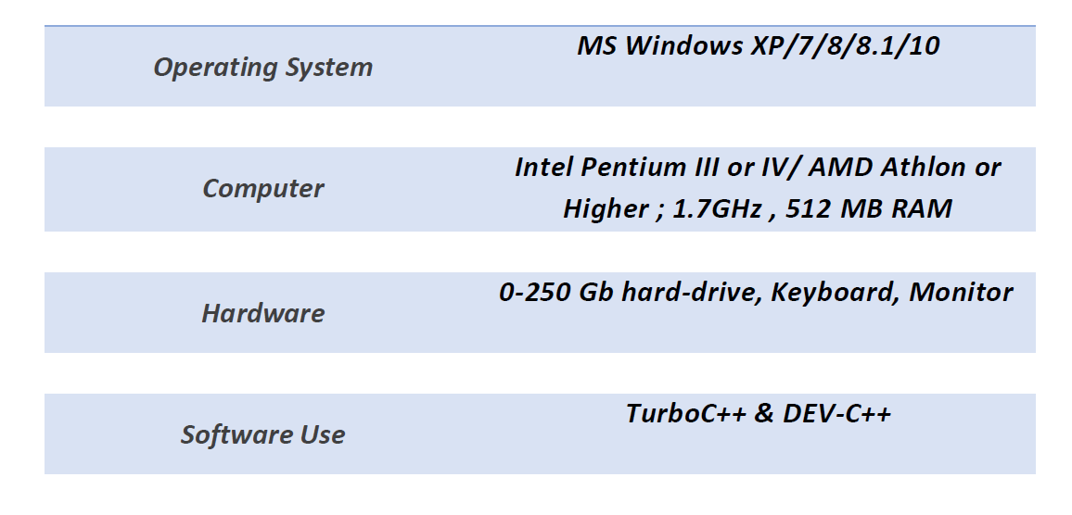
Requirements

Slide 5
OOP CONCEPT USED
Objects: Objects are basic run-time entities in an object oriented system. Each object contains data and code(functions) to manipulate data. Object is instance of class.
Classes: Class defines only structure or blue print of an object. Once a class is defined, we can create any number of objects belonging to that class. A class is a collection of objects similar types. Class is combination of data members and member functions.

Slide 6
OOP CONCEPT USED
Inheritance: Inheritance is the process by which objects of one class acquire the properties of other class. Through this each derived class shares the properties of base class.
Friend Function: Friend function can access the member function or the data members only within the class where it is defined. It is called without dot operator.It is not a member of class.

Slide 7
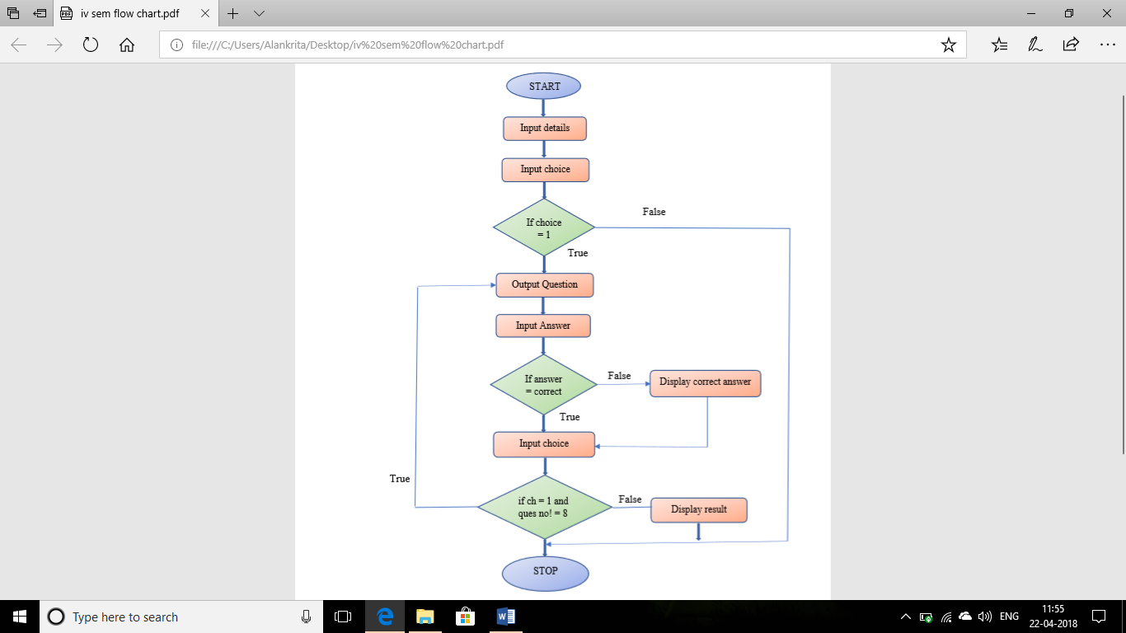
Flow Chart

Slide 8
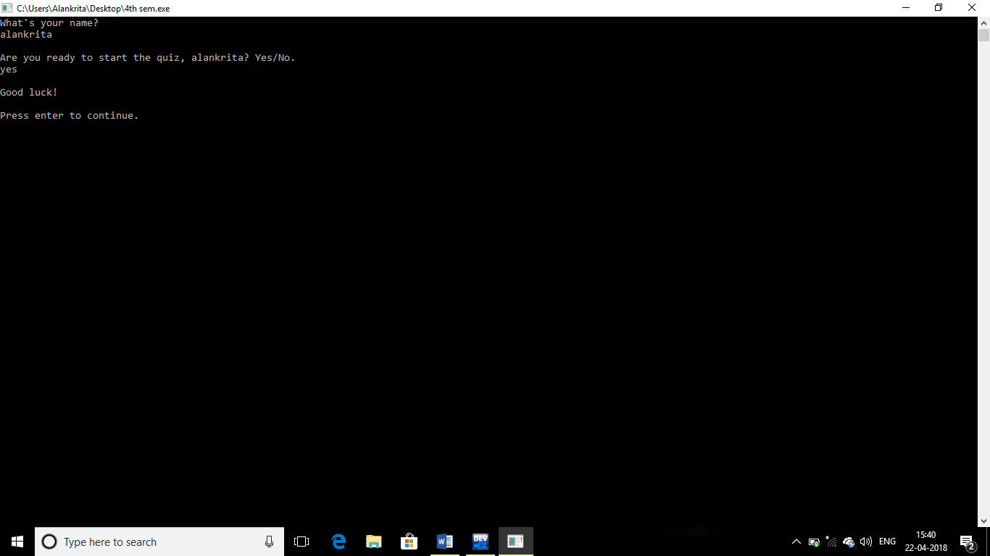
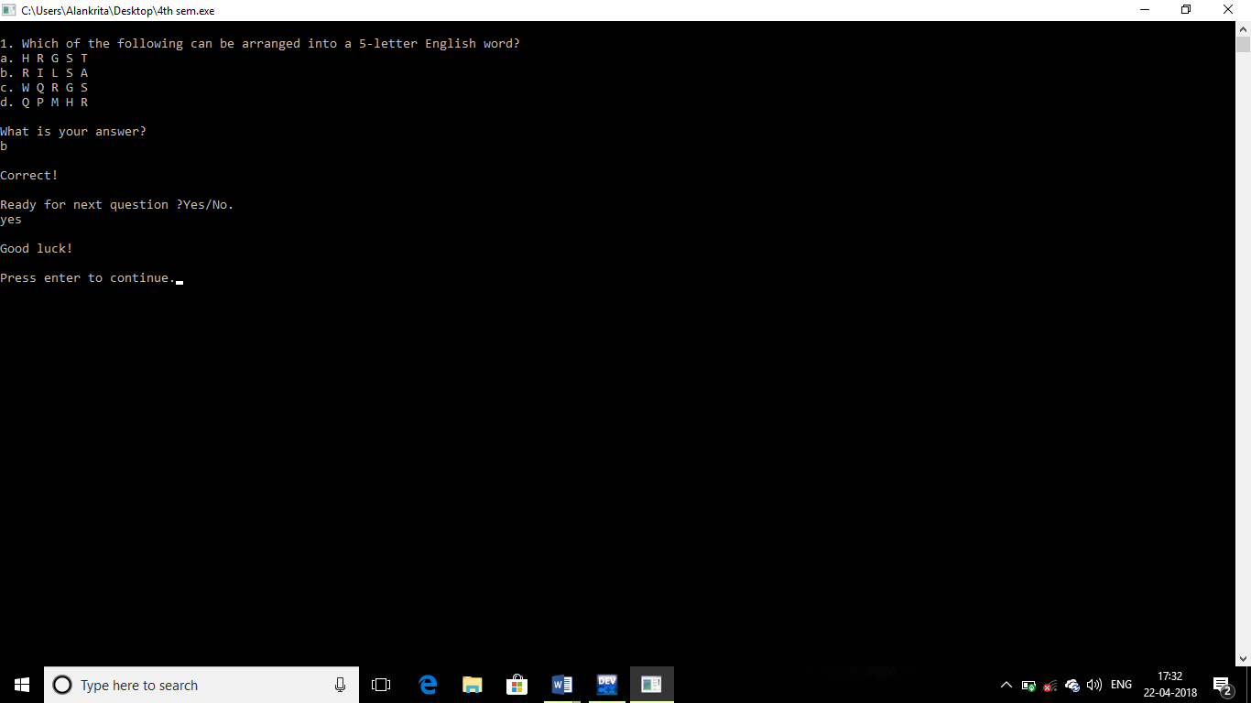
OUTPUT

Slide 9
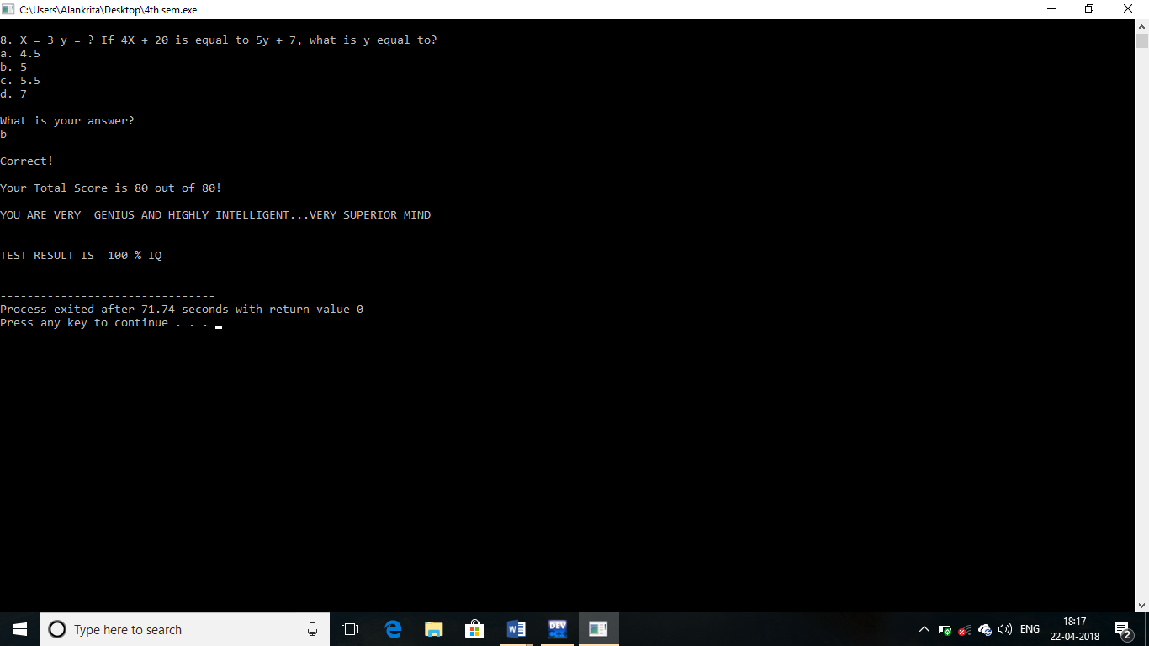
OUTPUT

Slide 10
THANK YOU

